Slide 1
Challenging Your Bias
Notes:
What words come to mind when I say diversity and inclusion? Political correctness, mindfield,
How often do you find yourself in a situation where you are the minority?

Slide 2
Goals for this session:
Better understand our own bias
Gain insight into the ways in which we perpetuate bias and stereotypes
Identify techniques can we use to challenge our bias
Notes:
Based substantially on the work of patricia cox. University of Wisconsin
Goals for this session:
Better understand our own bias
Insight into the ways in which we perpetuate bias and stereotypes
What techniques can we use to challenge our bias

Slide 3
3 Values that Matter To You

Slide 4
Curiosity, Humility, Empathy
Notes:
Resistence to consideration
How we want to approach this session.
Easy to get binary. Good people, bad people. Us and them
Easy to feel guilt but we want to move away from guilt to responsibility

Slide 5
unconscious bias
A bias that happens automatically and is outside of our control. It is triggered by our brain making quick judgments and assessments of people and situations, influenced by our background, cultural environment and personal experiences.
Notes:
You have all attended unconscious bias. In the program we established the idea that bias exists and is unintentional
We also discussed the idea that unintentional bias gets in the way of building a more diverse and inclusive organization, even though we know that diverse groups are more effective, productive and innovative.

Slide 6

Following the course, did you notice anything different about your thinking or actions?
Notes:
Following the unconscious bias course

Slide 7
bias
A bias is an inclination, both positive and negative, which inhibits judgement.

Slide 8
stereotype
A bias may be based on a stereotype, which is a positive or negative trait ascribed to a particular group.
Notes:
Stereotypes of canadians
Generally, we talk about stereotypes as if they refer to qualities inherent in people.

Slide 9
stereotype
Are positive stereotypes ‘ok?’
Notes:
Women are good communicators.

Slide 10
Ineffective strategies

Slide 11
Ineffective strategies for mitigating bias:
Suppression
Notes:
Pretend it doesn’t exist.
Convenient because many exist below our consciousness, it is easy to ignore

Slide 12
Ineffective strategies for mitigating bias:
Suppression
Colour Blindness (Group Blindness)
Notes:
I don’t see colour, I don't see gender. I love everybody.
Invalidates the experience of others

Slide 13
Ineffective strategies for mitigating bias:
Suppression
Colour Blindness (Group Blindness)
Belief in Your Personal Objectivity
Notes:
Everybody but me. Flies in the face of our values
So the question is how do we better understand bias and stereotypes and what can we do?
There are systemic changes that can be addressed. But what can you do?

Slide 14
Think of a time when your beliefs changed. What created the change?
Notes:
Since we are going to try and understand how to manage our unintentional bias, it's useful to think about change and what creates change for something as fundamental as a belief. Many of us were raised with the specific ideas of our parents. As we got older our views may have changed. What was the process for making that happen?

Slide 15
Dr. Patricia Devine - 3 Ideas
Our thoughts, feelings and behaviours are shaped by both intentional and unintentional processes.
Unintentional bias and stereotypes can influence us even when its in direct opposition to our values and intentions
We need more than good intentions to behave consistently with our values
Notes:
You have examples of how and why you changed your beliefs and mind about something. A lot of what we are going to cover is based on the work of Patricia Devine (Unoversity of Wisconsin). The foundation of her work is 3 ideas...
Explicit racism, sexism, and discrimination still exists.
But for most of us - certainly for those of us who are motivated to take this kind of course, when asked we would say we believe in fairness, in equality, and the inherent value of all people, regardless of the groups they identify with.
At the start of this session I asked you to think about three values that are important to you. It's likely that at least one of those values supports the idea that all people are equal. That if asked, you would say your values would be in direct conflict with racism, discrimination.

Slide 16
Bias and Stereotypes as habits of mind.
Notes:
Patricia Cox has based her research on the idea that bias is a habit of mind.
How is it that we can hold values contrary to prejudice but still be biased.

Slide 17
Breaking a Habit
Notes:
What conditions are necessary to break a habit?

Slide 18
Breaking a Habit
Motivation
Awareness
Strategy

Slide 19
Motivation
Resistance
Notes:
Two parts to motivation when it comes to bias and stereotypes:
We not only need to want to behave consistently with our values, but we also need to accept or be open to the idea that we are not objective.
When it comes to discussing and exploring bias, we can find resistance. Nobody wants to think they are prejudice. Think back to the three values you identified.
We get defensive. We look for alternate explanations. Part of the process of finding motivation is to stop resisting and start considering.

Slide 20
Motivation
Resistance
Dominant vs Non-Dominant Groups
Notes:
Each of us forms our identity in part, through the groups we identify with. Throughout society and organizations there are dominant groups and non-dominant groups. In most cases, dominance is determined by power and status.

Slide 21
Motivation
Resistance
Dominant vs Non-Dominant Groups
Perceptual Lens
Notes:
Whether we are in the dominant or non-dominant group informs our perceptual lens.
Our perceptual lens, our way of seeing the world is determined by so many things including our beliefs, upbringing, experiences. We are not objective, even when we think we are. And if you are part of a dominant group, you ability to understand the experience of a non-dominant group is obscured by your perceptual lens
Part of the process of finding motivation to break the bias and stereotype habits is a willingness to accept the idea that your experience of the world may be heavily informed by the groups you identify with.

Slide 22
Awareness
Notes:
So if you can find motivation, if you believe that you may have bias that is contrary to your values, you can begin to pay attention to your thoughts and beliefs and how they manifest.
Acknowledging that you are biased and being motivated to do something about it, then creates opportunity for you to bring attention and awareness to your bias.
Because so much of what happens in our heads is unconscious, it is easy to be out of touch which not only our bias but also our beliefs.
We start to build awareness by paying attention. By examining our automatic thoughts. By unraveling what is behind some of our beliefs.
In Buddhism, they talk about the ability to sit in the third chair, to observe ourselves and our thinking.
This is about cultivating curiosity

Slide 23
Awareness
Sit in the third chair
Notes:
In Buddhism, they talk about the ability to sit in the third chair, to observe ourselves and our thinking.
This is about cultivating curiosity

Slide 24
Activity:
Complete the judgements worksheet.
Notes:
Exercise on statements:
Spread out. I am going to show you a statement and you are going to write down whether you think it is mostly true or mostly false. Don’t overthink it. Whatever you write is just for your eyes. You aren’t going to have to share anything. We are going to debrief this exercise but you don’t have to share any of your answers.
Debrief: any surprises? What did you notice? Why is there a question about luck versus hard work?
Think back to our discussion at the beginning about how you changed your mind about a belief. What did you do?

Slide 25
What did you notice?
Any clues as to possible bias’ you might hold?
Notes:
Exercise on statements:
Spread out. I am going to show you a statement and you are going to write down whether you think it is mostly true or mostly false. Don’t overthink it. Whatever you write is just for your eyes. You aren’t going to have to share anything. We are going to debrief this exercise but you don’t have to share any of your answers.
Debrief: any surprises? What did you notice? Why is there a question about luck versus hard work?
Think back to our discussion at the beginning about how you changed your mind about a belief. What did you do?

Slide 26
Why are stereotypes so persistent?
Notes:
Now, as part of building our awareness, we not only want to sit in that third chair and observe our thoughts and behaviours, but it is also helpful to understand a little more about bias:

Slide 27
Stereotypes are descriptive and prescriptive:
We have a belief about how people DO behave but also how people SHOULD behave.
Notes:
Bias’ are often based on stereotypes and stereotypes are prescriptive norms and how people do but also should behave.
There are often negative consequences when people don’t conform to stereotypes.
We colour the world with our expectations, and once a judgement is made, its very hard to change that judgment because we attend to and process information and evidence in a way that perpetuates the stereotype. We see what we expect to see and reject any info that challenges those expectations

Slide 28
Perception + Behaviour
We don’t believe what we see, we see what we believe.
Notes:
Our stereotypes influence our perceptions of others, causing us to make them seem more stereotype-consistent.
And they influence our behaviour, leading us to interact with others in ways that elicit stereotype-consistent behaviour from them.
We don’t believe what we see, we see what we believe.

Slide 29
Reconstructing Credentials
Notes:
This is a biased way in which we ensure our expectations around stereotypes are met. So we make a decision and then we construct evidence to explain it. Use information to justify our decision.
So if you think about itnerviewing for a CTO role. The stereotype historically has been this is a male role. So you have that gut feeling - male and CTO go together and you decide that is the right candidate and then you look for evidence to support that decision
Unintentionally adjusting credentials to favour the stereotype congruent group.
I know I am going to blow everybody’s mind when I say that Astrology has no scientific evidence to support it.
Particularly dangerous because it is easy to convince ourselves that we have evidence to support our view. WE think we are unbiased.

Slide 30
Self-Fulling Prophecy and Stereotype Threat
Notes:
Self-fulfilling prophecy: your expectations about a particular group associated with a stereotype actually cause you to behave in a way that causes others to live up to the stereotype.
Rosenthal and Jacobson bloomer experiment
Stereotype threat: In one experiment, female job applicants were divided into two groups, one being told that their male interviewer had traditional views about women, the other nontraditional. Women in the first group downplayed their ambitions and behaved much more stereotypically femininely during the interview than those interviewed in the nontraditional cohort.

Slide 31
Stereotypes influence how we process, and attend to, information in a way that perpetuates the stereotype.
Notes:
Potentially real ways in which stereotype affect our behaviour in ways that reinforce the stereotype
Attentional spotlight: Our brain draws attention to things that are consistent with our expectations. You will miss information that is inconsistent with the stereotype you hold. (Darly and Gross Hannah Experiment)
Confirmation bias - we give greater weight to conforming evidence. A confirmation bias is a type of cognitive bias that involves favoring information that confirms your previously existing beliefs or biases.
Darly and Gross - Hannah experiment. See video of Hannah. Told she is in the fourth grade and they are either led to believe that Hanah is high socioeconomic status or low socioeconomic status. What do you think the stereotype is? Low socioeconomic status is related to poor school performance. They then see hannah taking a test. She has really mixed results. But the teachers who thought she was low in ses remembered only the easy questions she got wrong and forget the difficult ones she got right. .

Slide 32
Untested Assumptions
Notes:
The neural connections between our associations get stronger as we find info that confirms are stereotypes and bias. So in some senses, simply holding a stereotype has a kind of self-reinforcing effect.
Experiment done by Cox and Devine found that even when people were provided with information that contradicted their stereotype, their belief didn’t change. In fact for every one incident that confirmed the stereotype, it took three disconfirming incidences to counteract their perception.
In fact, there is some research that shows that when we even when we do not receive contradictory information, the brain interprets the absence of info as confirmation of the stereotype

Slide 33
Activity: Complete the Acceptable Prejudice Worksheet
Notes:
Acceptability of prejudice exercise

Slide 34
Why are some prejudices more acceptable than others?
If you know people who belong to some of the different groups identified in the worksheet, do you have a different perspective?
Notes:
Which one is the worst? Is there a circumstance where you can imagine not being prejudice toward that group?

Slide 35
Quick Break - 10 mins

Slide 36
Activity: Complete the Worksheet on Your Bias
Notes:
My Bias and stereotypes. Find at least one. We are going to come back to it.

Slide 37
Strategies

Slide 38
Breaking a Habit
Motivation
Awareness
Strategy
Notes:
Okay so we can build our awareness not only around our beliefs and bias but also in our understanding of how bias perpetuates.
But, what to do? What strategy can we employ to overcome the bias?
Stereotype replacement: imagine a tech leader
Watching movies, reading
Search - African American Tech leaders
Media portrayl (women represent less than 30% of all speaking roles in film - Geena Davis institute)

Slide 39
Strategies
Stereotype Replacement
Detect, Reflect, Reject
Notes:
Detect - Reflect - Reject
When am I most vulnerable to stereotyping. Sometimes it depends on your physical statement - we are more likely to rely on stereotypes when we are tired, hungry or distracted.
But sometimes it might have to do with your particular stereotype reliance. This is why we did the exercises.

Slide 40
Stereotype Immersion
Notes:
So much of media, tv, movies is bombarding us and influencing our perception and beliefs around stereotypes.
Pay attention to how things are presented, what words are used, how often do we see different types of people

Slide 41
Strategies
Stereotype Replacement
Detect, Reflect, Reject and Replace
Notes:
Not only Detect - Reflect - Reject but also replace.
So we need identify not only why that isn’t accurate but also a replacement

Slide 42
Think of a Tech CEO
Notes:
Most people will think of a white male in a hoodie

Slide 43
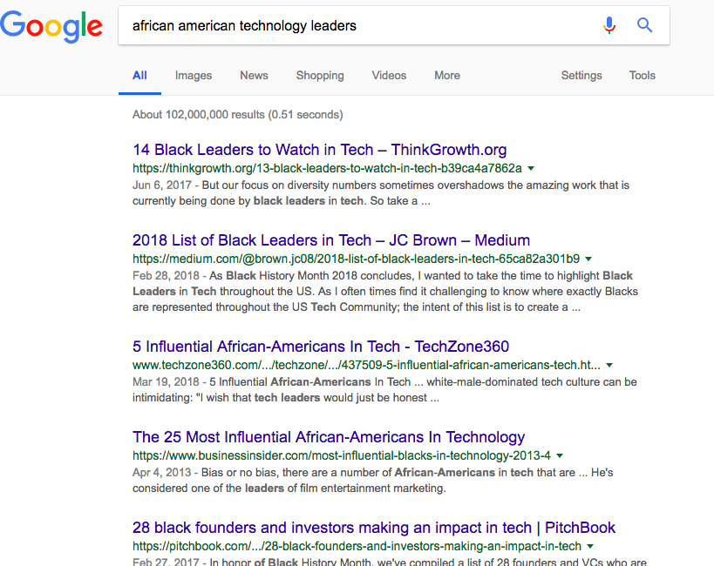
Notes:
Media portrayed (women represent less than 30% of all speaking roles in film - Geena Davis institute)

Slide 44
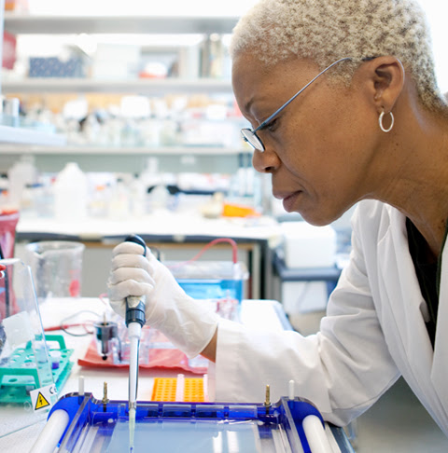


Slide 45
Strategies
Stereotype Replacement
Individuating
Notes:
What makes people unique?
Stereotypes fill in gaps
If you can’t find out, then make a deal with yourself that you will consciously look for disconfirming evidence
Proactive or retroactive

Slide 46
Strategies
Stereotype Replacement
Individuating
Perspective taking
Notes:
Increased salience of inequalities
Also proactive and retroactive
Taught to children - kindergarten through grade 2
Todd, Bodenhausen, Richeson, Galinsky 2011 - Northwestern University and the University of Cologne.
Perspective taking of African Americans. Saw a movie or a picture. Wrote an essay, or were asked to think about the individuals perspective, feelings, ideas while watching
Men crossing the street to give women space

Slide 47
Strategies
Stereotype Replacement
Individuating
Perspective taking
Situational Explanations
Notes:
Attribution error (about them as persons, versus about my situation)
Fundamental attribution error (tendency to internally attribute negative outgroup and positive ingroup behaviour and to externally attribute positive outgroup and negative ingroup behaviour.)

Slide 48
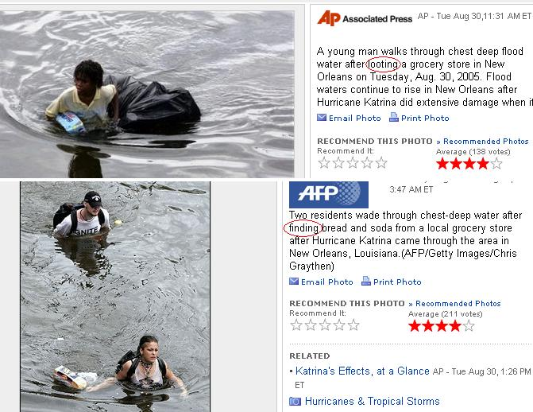
Notes:
What assumptions do we make? Apparently the photographer in the first picture said he did see the individual steal from a store. But in the second photo, the photographer didn’t see what happened, however he did assume that they weren’t stealing.
Consider who and why we assume positive intent for some people but not others?

Slide 49
Discussion: Using a personal bias as your focus, brainstorm ideas in your group to apply one or more of the four strategies to mitigate bias.

Slide 50
Summary

Slide 51
Unintentional bias and stereotypes can influence us even when in direct opposition to our values and intentions
We can think of bias as a habit of mind.

Slide 52
Pay careful attention: examine our bias’ and the messages we constantly receive.
Deconstruct the stereotypical thought and/or messages, and replace with new ones

Slide 53
Techniques:
  Stereotype Replacement
  Individuation
  Perspective taking
  Situational Explanations

